Slide 1


Influence of process parameters on additive friction stir processing of 7075 Al alloy for defence applications
In assistance with Defence Institute of Advanced Technology
DRDO(GOI)
Guide : Prof. H.A. Deore
Group members : 1)Shubham Wadekar
2)Ravi Soladhra
3)Nilkanth Thombare
4)Hemant Barkade

Slide 2
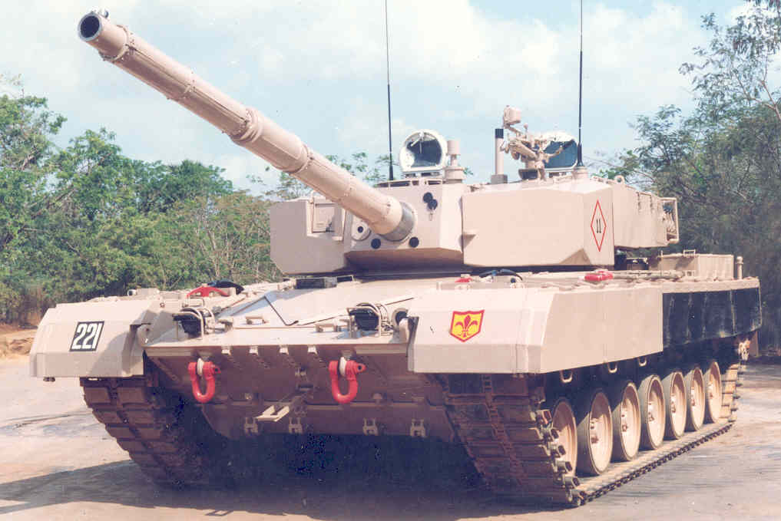
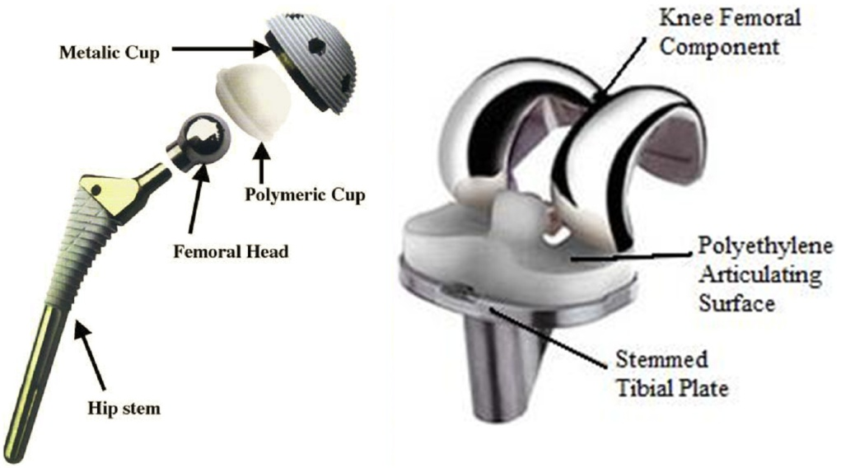
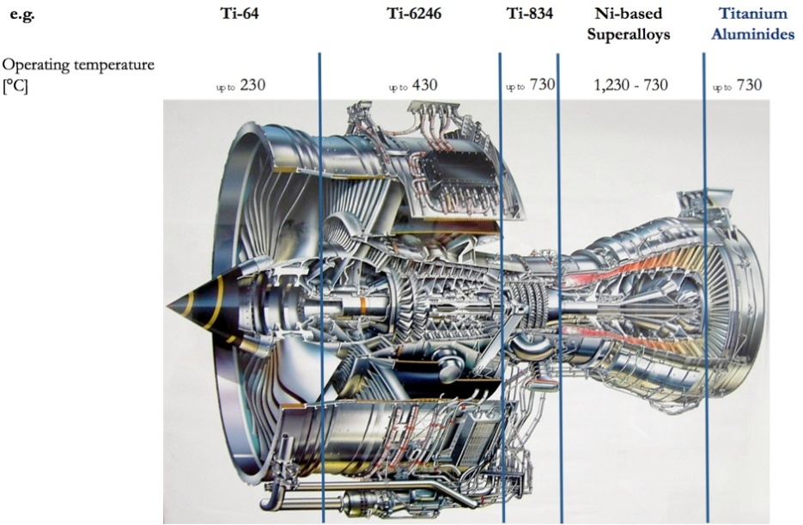
Problem definition
Problem: Technology advancement has given many solutions to various problems but it also created new problems, like
High end products requires very demanding and precise property requirements for the materials Imp Requirement : Ultrahigh strength to weight ratio with good Impact resistance over very large Temperature range (Cryogenic Temp(-200°C ) to very High temp. (2000°C)

Slide 3
General Solution
Use of Light Weight Materials….
Light Weight Metals:
Metal | Density (Kg/mm²) | Tensile Strength (MPa)
Aluminium alloy (7075-T6) | 2.81 | 572
Magnesium alloy (AZ31) | 1.74 | 272
Titanium alloy (Beta C) | 4.81 | 1250
Beryllium-copper alloy (25) | 8.25 | 1400
Various Strengthening Mechanisms:
Alloying (Formation of Solid Solutions)
Precipitation Hardening
Dispersion Strengthening
Phase Transformations (Heat Treatment)
Composite Formation
Grain Refinement

Slide 4
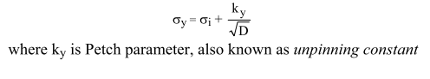
Grain Refinement
Grain refinement is the only strengthening mechanism, which increases hardness and strength of metal without compromising ductility (Impact Toughness)
Hall-Petch Relationship:
Coarse
Fine

Slide 5
Severe Plastic Deformation (SPD)
What is SPD…?
Severe plastic deformation (SPD) may be defined as metal forming process in which an ultra-large plastic strain is introduced into a bulk metal in order to create ultra-fine grained metal.
The structural changes caused by SPD are reflected in improved mechanical properties of metals.
Process of producing polycrystalline material to obtain uniform strain in material.
Potential of achieving the sub-micrometer crystal structure upto nanometric scale.

Slide 6
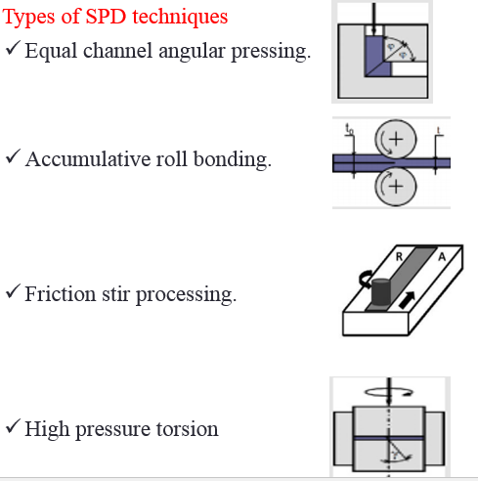
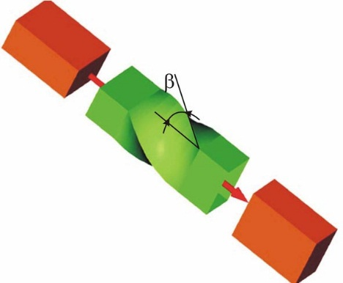
High Pressure Torsion
Some of the SPD Techniques
Equal Channel Angular Extrusion
3d Forging
Twist Extrusion (Y.Beygelzimer, 1999)
& Friction stir Processing
Notes:
This slide shows the schemes.
In HPT, a thin disk is twisted between two anvils under pressure.
In ECAE, a bulk specimen is extruded through an angular channel.
As a result, the bulk accumulates large equivalent strain

Slide 7
Friction Stir Processing
Friction stir processing (FSP) has been proposed by Mishra et al. ^{[1]} as a generic tool for microstructural modification based on the basic principles of FSW. Mishra utilized the following unique feature of FSW process:
Low amount of heat generated,
Extensive plastic flow of material,
Very fine grain size in the stirred region,
Random misorientation of grain boundaries in the stirred region,
Mechanical mixing of the surface layer
large forging pressure,
Controlled flow of material.
FSW and FSP have similar technologies but different goals.

Slide 8
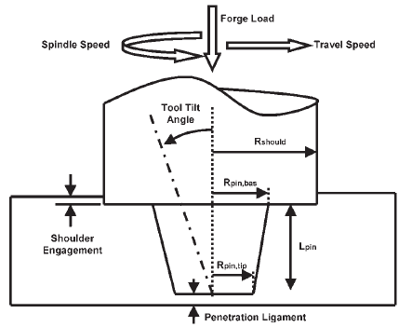
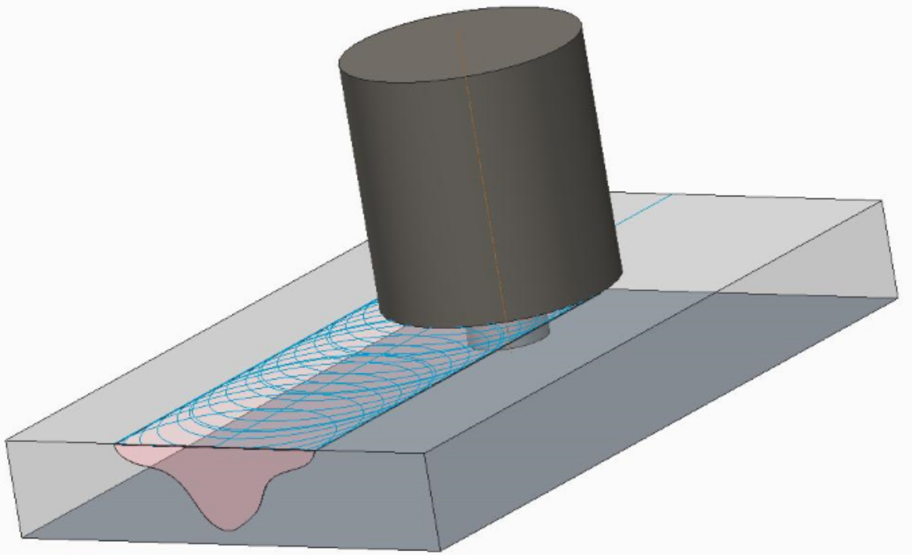
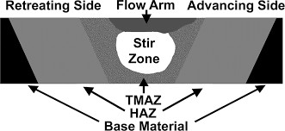
Principle of Friction Stir Processing
Downward force
Direction of tool travel
Tool rotation
FSW/P region
Retreating side
Shoulder
Pin
Advancing side
Fig 2. Tool tilt, shoulder Engagement, penetration legament
Nugget
Fig 1. Fiction Stir Processing

Slide 9
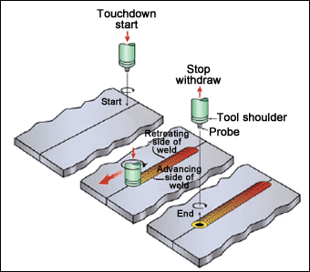
General Arrangement:
A non-consumable rotating tool with a specially designed pin and
shoulder is inserted into the abutting edges of sheets under the axial load [1].
Heat is generated because of friction between tool and workpiece and plastic deformation of workpiece [1].
This heating softens the material around the pin and combination of tool rotation and translation leads to movement of material from the front of material [1].
Mixing of workpiece material produces joining.
Fig1 : Schematic diagram of FSW process[2].

Slide 10
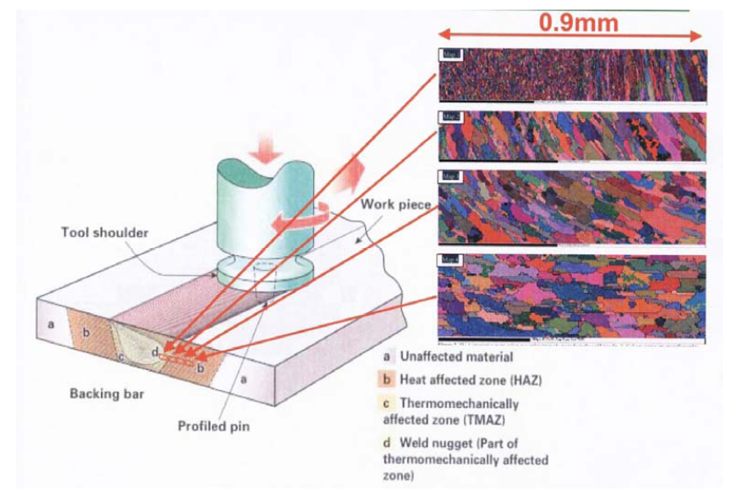
Microstructural zones:
Equiaxed and
fine grains.
Significantly
deformed , rotated.
Significant effect if
the microstructure is
thermally unstable.
Fig 2 : Different zone produce during FSW [3].
Reference: A.M. Khorsid, Investigation of the mechanical properties of Friction Stir Welded 6061 Al plates.

Slide 11
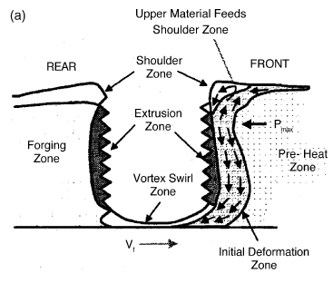
Material Flow:
Material flow pattern shows following zones:
A)Preheat: Temperature rises due to the frictional heating of the rotating tool and adiabatic heating because of the deformation of material.
B) An initial deformation: This zone forms when material is heated to above a critical temperature and material flow started.
C) Extrusion: In this zone with a finite width, material flows around the pin from the front to the rear.
D) Forging: The material from the front of the tool is forced into the cavity left by the forward moving pin under hydrostatic pressure conditions.
E) Post heat/Cool down: The material
cools under either passive or forced cooling conditions.
Fig.3 : Metal flow patterns[1].
Reference: R.S. Mishra, Friction stir welding and processing.

Slide 12
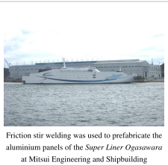
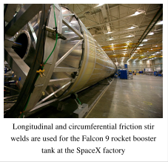
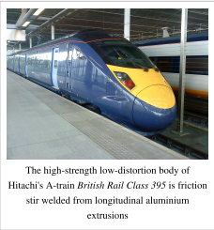
Applications:
Marine: (low distortion)
fish freezing plants for fishing vessels
aluminium superstructures of cruise ship
Aerospace: (virtually zero defect)
welding in fuel tanks of rockets/ Space Shuttle
airframe Welding ( Replacing rivets)
Rail: (complex structures, low distortion)
welding of High speed aluminium railcars
Automotive: (complex shapes, high volume/low cost)
welding of components like suspension parts,
wheels, seat components, crash boxes
lightweight armoured vehicles (thin sheets)

Slide 13
Research Gap:
After reviewing most promising papers in the area of Additive Friction Stir Processing (AFSP), following research gap has been noted:
After reviewing literature, it is found that, most of the authors have done FSP on aluminium 6061,5052 and other alloys but 7075 has got less attention.
For AFSP, one needs to consider lot of process parameters like Tool parameters (Tool material, tool geometry, tool tilt angle), process parameters (Rotational speed, traverse speed, plunge depth) and additive parameters (additive material, size, fraction, combination
Objective:
After finding research gap in additive Friction Stir Processing process from surface modification point of view, following research objectives has been finalised.
Design and conduct FS processing experiments on aluminium alloy for different combinations of rotational and translational speeds.
Influence of different parameters on the properties of Al 7075 with respect to Microhardness, wear and its microstructure.

Slide 14
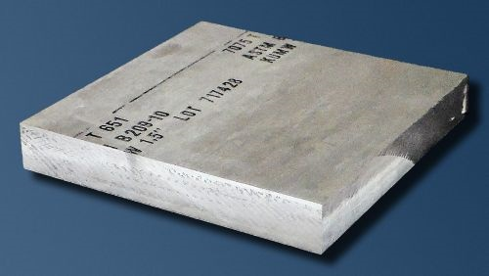
7075 Aluminium Alloy:-
Composition :
Zinc :- 5.6 – 6.1%
Magnesium :- 2.1 – 2.5%
Copper :- 1.2 – 1.6%
And less than a half percent of silicon, iron, manganese, titanium, chromium, and other metals.
Properties:
Strong with strength comparable to many steels.
Good fatigue strength and average machinability.
Less resistance to corrosion than most of the al alloys.
Relatively high cost limits.

Slide 15
Parameters
Friction Stir Welding:
Rotational Speed
Traverse Speed
Tool Tilt
Plunge Depth
Friction Stir Processing:
Rotational Speed
Traverse Speed
Tool Tilt
Plunge Depth
Overlap
Additive Friction Stir Processing:
Rotational Speed
Traverse Speed
Tool Tilt
Plunge Depth
Overlap
Filler Percentage
Filler Material

Slide 16
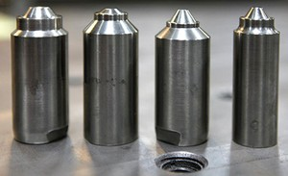
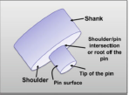
Tool Material:
Tool material and design
Types of tool materials used in FSP :
Tool steel
WC-Co
Ni alloys
Composite materials
W alloys
PCBN
Tool Design :
Tools are classified as :
Fixed
Adjustable
Self reacting(bobbin type)

Slide 17
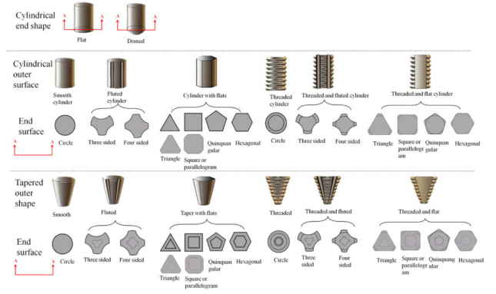
Different types of tool shapes are as follows:

Slide 18
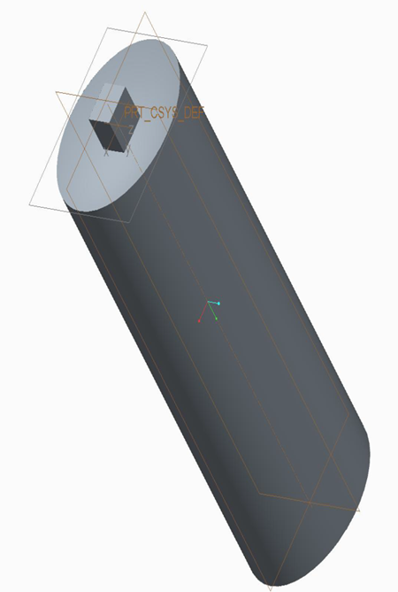
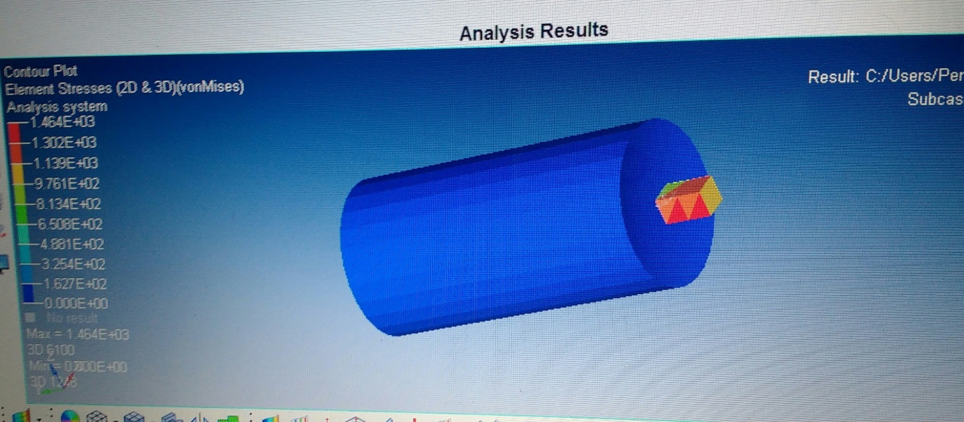
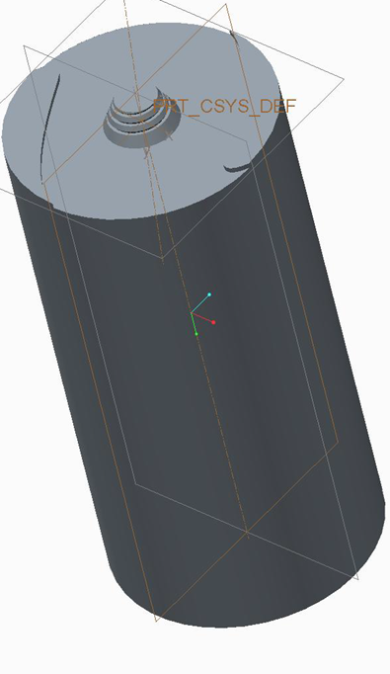
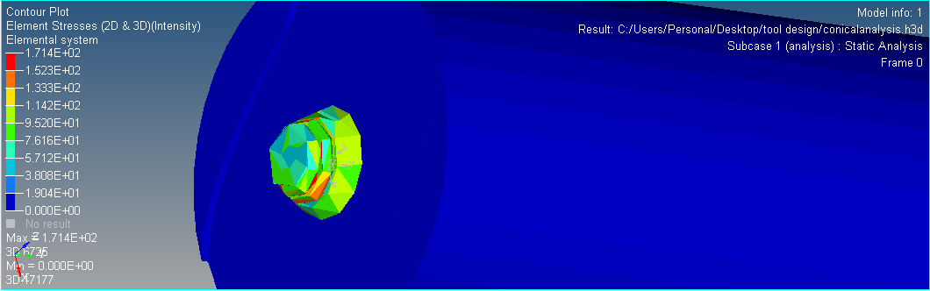
1) Square tool profile with concave shoulder:
2)Tapered cylindrical tool with thread and end feature:

Slide 19
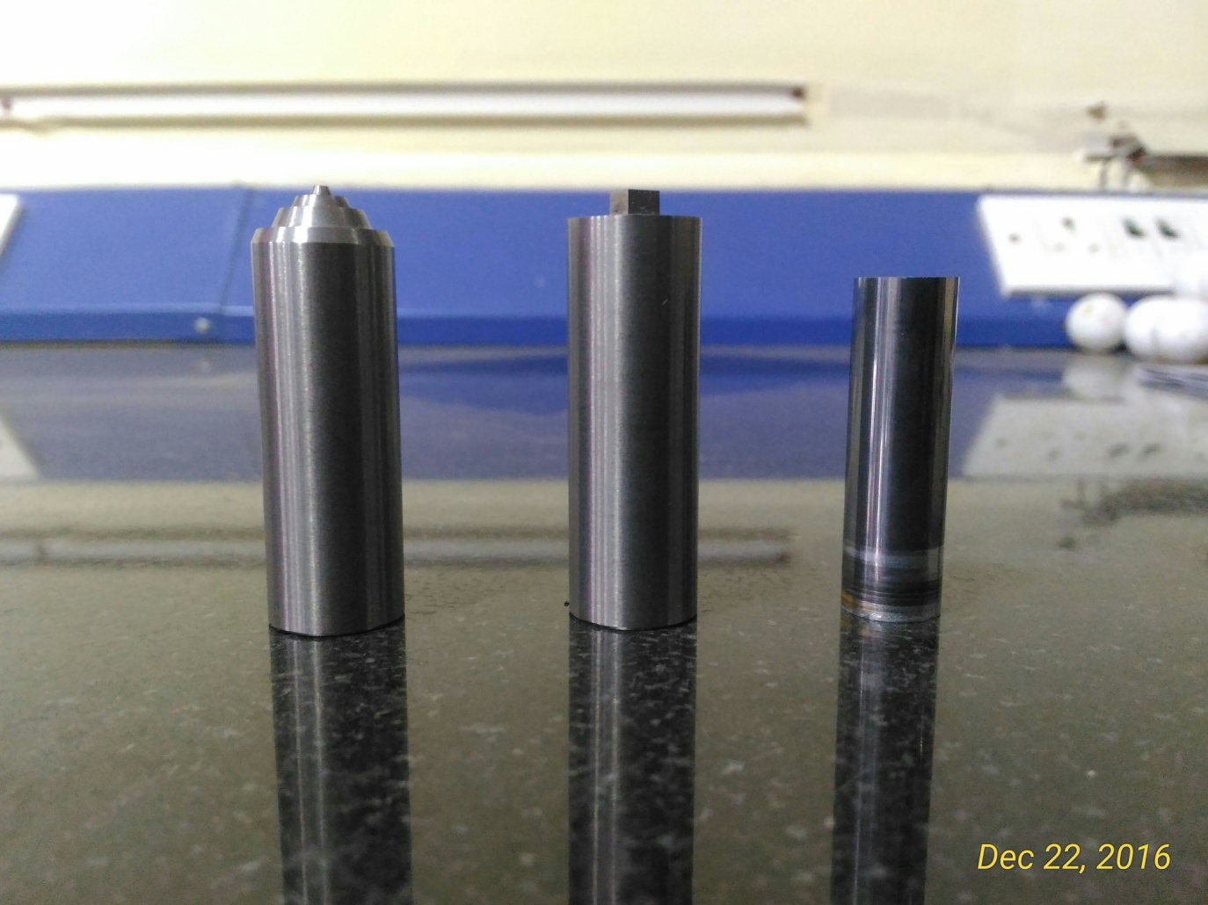
Tools manufactured

Slide 20
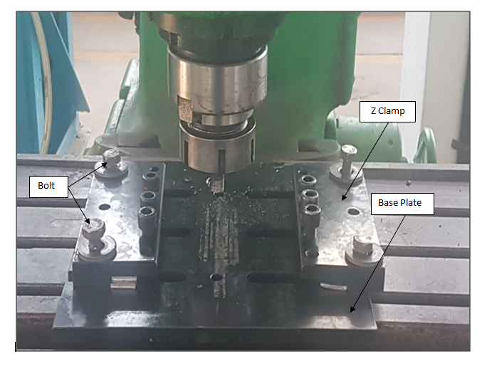
Fixture Design

Slide 21
Design of Experiment
SR.NO | Parameters Of FSP | I | II | III
1. | Rotational speed (rpm) | 900 | 1150 | 1400
2 | Traverse speed (mm/min) | 30 | 40 | 50
3 | Overlap | 50 % | 60 % | 60%
4 | Filler material | Cu | CNT | SiC

Slide 22
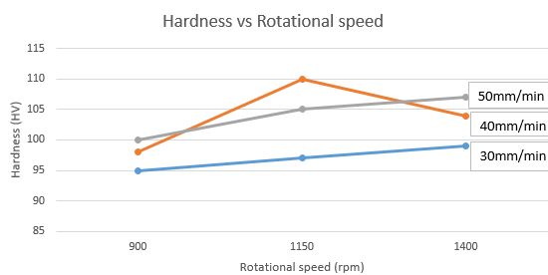

Slide 23
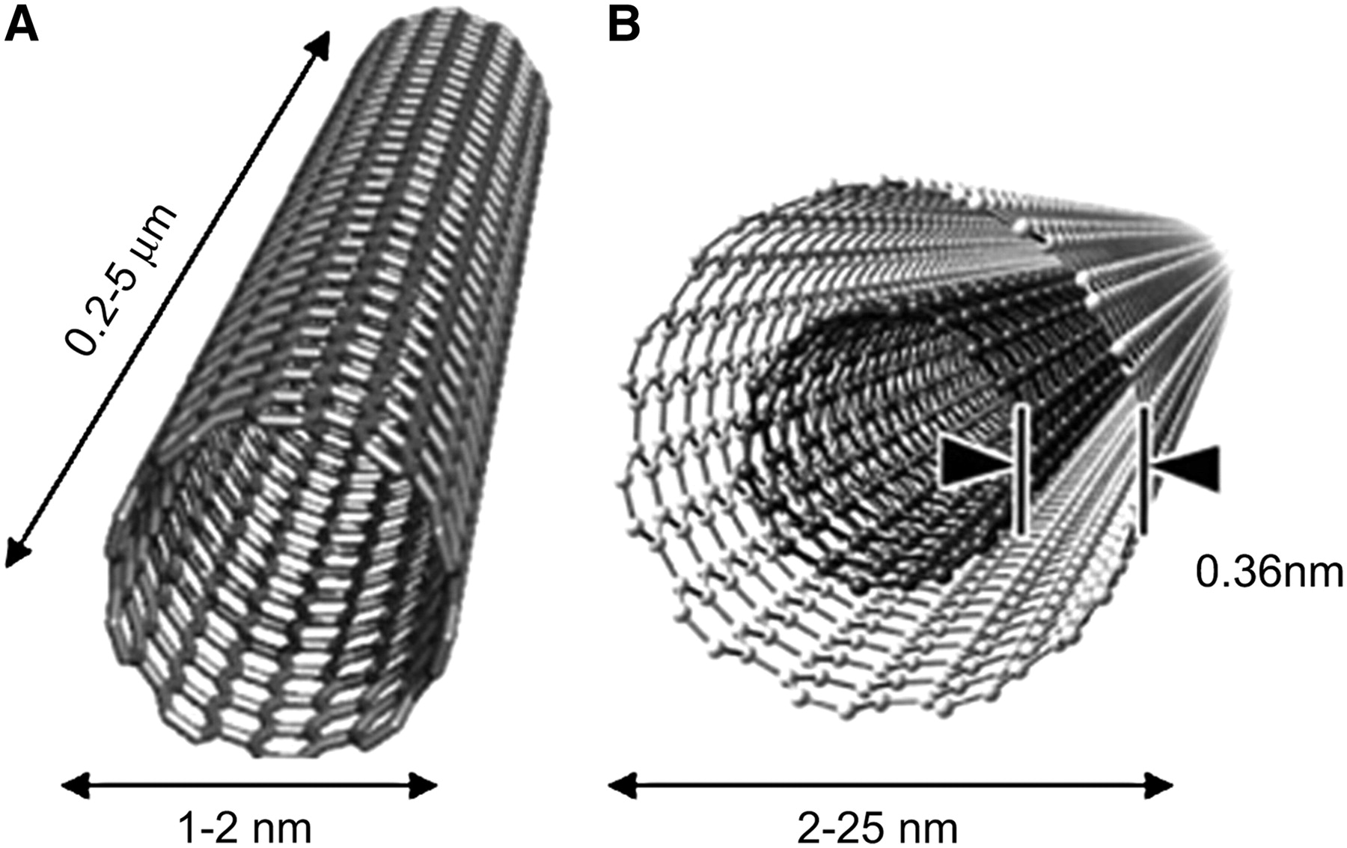
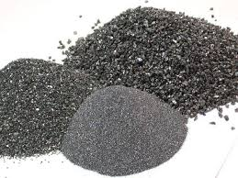
Filler Materials:
1) Carbon Nanotubes
A carbon nanotube is a tube-shaped material, made of carbon, having a diameter measuring on the nanometer scale.
A nanometer is one-billionth of a meter, or about 10,000 times smaller than a human hair.
Carbon Nanotubes are used as filler material to increase surface hardness
2) Silicon Carbide (SiC)
SiC has chemical stability, high thermal conductivity, smaller thermal expansion coefficient and better abrasion resistance.
It is a semiconductor and resistant to oxidation in high temperature.
SiC is used in many applications such as strengthening materials for Al, Al₂O₃, Mg, and Ni also for polishing abrasive, high hardness grinding material etc.

Slide 24
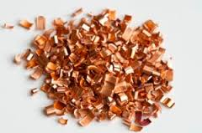
3) Copper
Copper is used as precipitation hardening alloy.
It is soft, ductile, malleable metal with very high thermal and electrical conductivity.

Slide 25
Experimental Details
Sr.No | Operations | Machines Used | Objectives
1 | Cleaning and Washing | - | To remove dirt and oil particles.
2 | Cutting | Power Shear | To make standard size plate.
3 | Marking and Slot making | 1.Milling M/c (Metal Slitting cutter). 2.Hand Drilling M/C | To make slots and drills for powder filling.
4 | Powder Filling | - | To conduct AFSP
5 | Powder Locking | Vertical Milling M/C | To avoid scattering and pullout of powder during FSP
6 | FSP/AFSP | Vertical Milling M/C (FSP Tool) | To obtain fine grain microstructure and other project objectives as mentioned above.

Slide 26
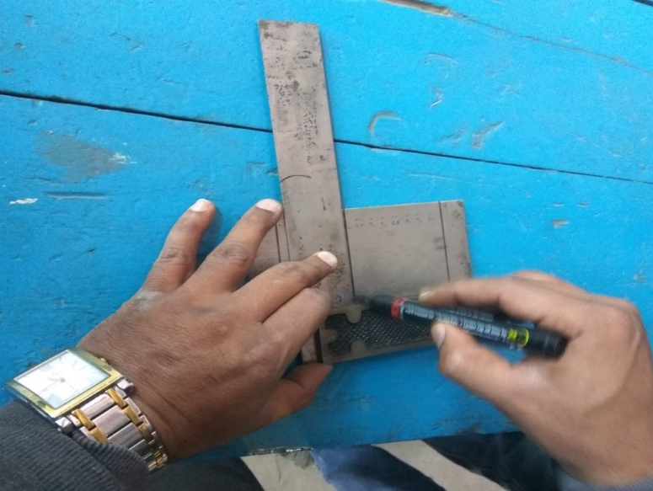
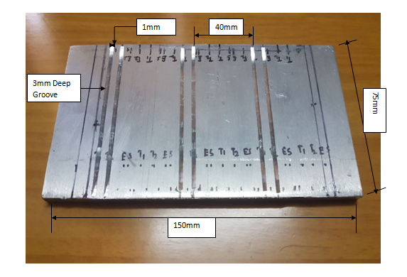
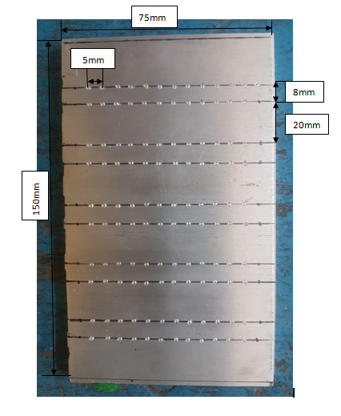
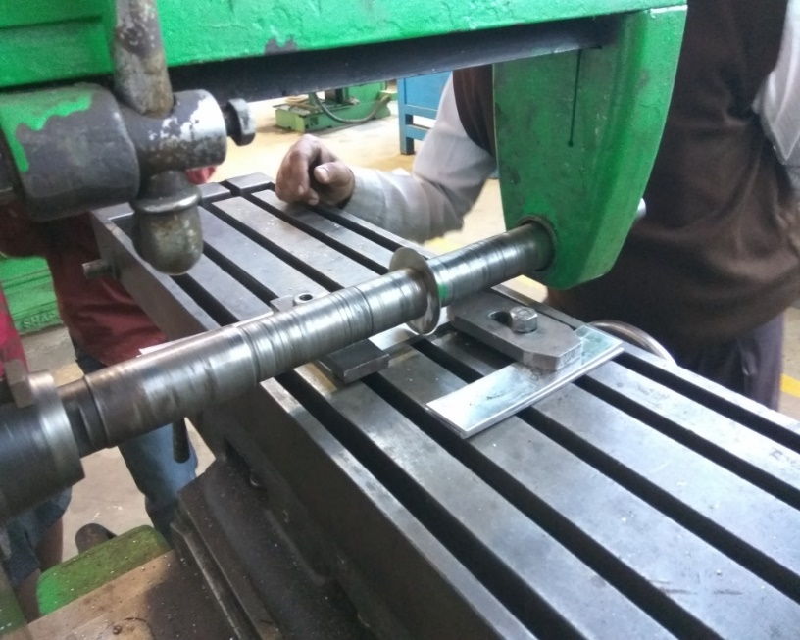
Marking and Slotting

Slide 27
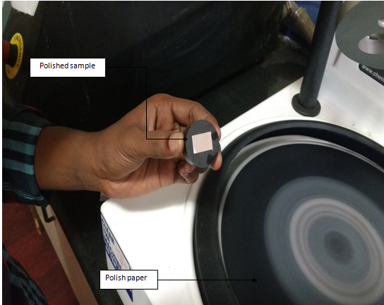
Sample and sample preparation

Slide 28
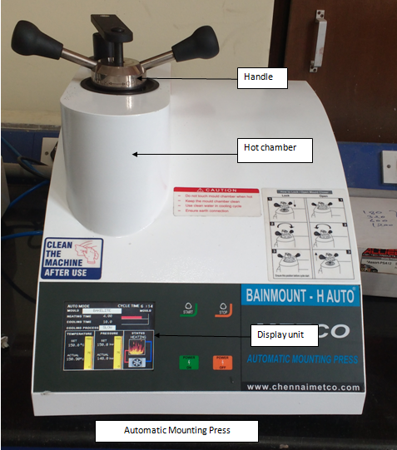
Mounting

Slide 29
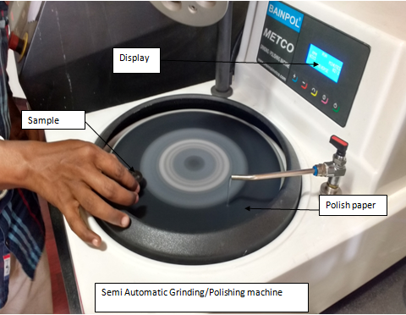
Surface Finishing

Slide 30
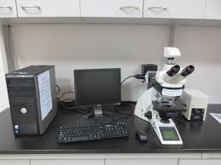
Results and discussion
Characterization
Optical microscopy
The optical microscope, often referred to as light microscope, is a type of microscope which uses visible light and a system of lenses to magnify images of small samples.
The best resolution for an optical microscope is about 0.2 microns.
Lyca Optical Microscope

Slide 31
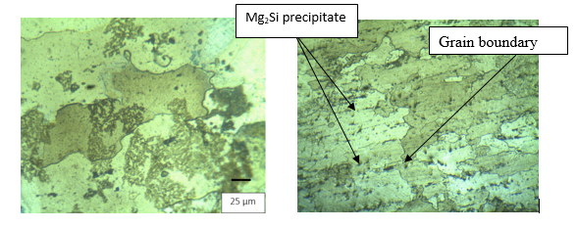
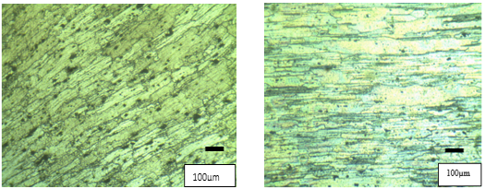
Optical microscopy of 7075 parent material
Optical microscopy for SiC particles(100x)

Slide 32
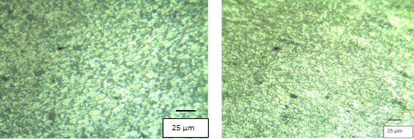
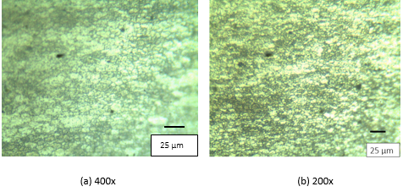
Optical microscopy of Cu(400x)and (200x)
Optical microscopy of CNT particles

Slide 33
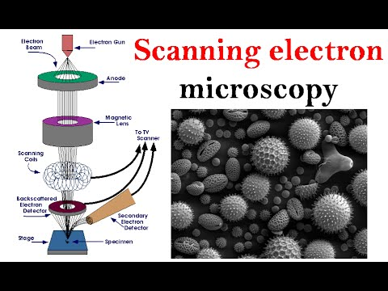
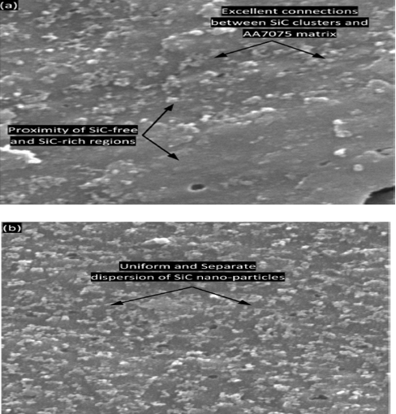
Scanning electron microscopy (SEM)
A scanning electron microscope (SEM) is a type of electron microscope that produces images of a sample by scanning it with a focused beam of electrons. The electrons interact with atoms in the sample producing various signals that contain information about the sample's surface topography and composition. SEM can achieve resolution better than 1 nanometre.
SEM image of distribution of SiC nanoparticles in Al 7075 matrix

Slide 34
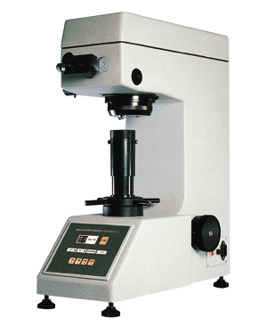
Microhardness
Microhardness vs. Aluminium samples
Vickers hardness tester

Slide 35
Microhardness vs. Aluminium samples(SiC)

Slide 36
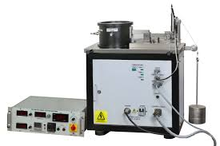
Wear Rate
Wear testing machine
Weight loss vs Sliding distance

Slide 37
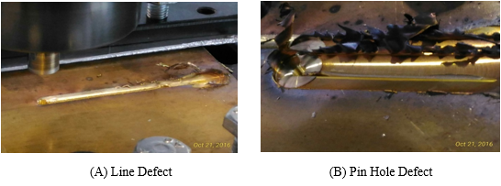
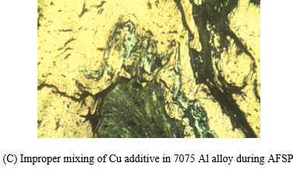
Defects

Slide 38
Conclusion
By using Simple Cylindrical pin tool geometry, higher rotational speeds are required to get defect free processed zone, as material sticks to pin at lower rotational speed. Due to higher RPM heat generation is more which leads to grain coarsening in HAZ.
It was found that increasing the tool rotational speed improved the distribution of additive particles.
Also the bonding between Al alloy and SiC particles can be seen in SEM.
Due to addition of different types of additives in aluminium matrix surface properties are enhanced such as hardness and wear rate.
Silicon carbide is used for dispersion strengthening of aluminium alloy.
Among the three additives used for AFSP, SiC gives the best results for wear and hardness test.

